Slide 1
Convolutional Neural Network (CNN)
Network Architecture designed for Image
Notes:
-- We are going to design network. For image only
-- A neuron for a region (Receptive field)
-- Sharing the weights
-- The above two are CNN layers.
==========
-- multiple layers of CNN
-- Pooling
-- Typical CNN
-- Applications on GO
==========
More applications

Slide 2
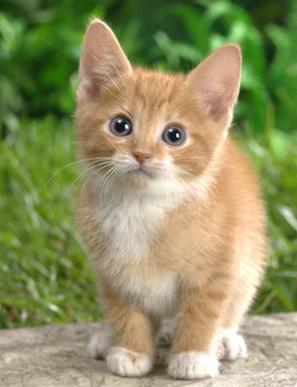
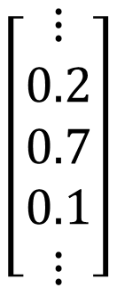



Image Classification
$$\left[\begin{aligned}⋮ \\ 0.2 \\ 0.7 \\ 0.1 \\ ⋮\end{aligned}\right]$$
$$\left[\begin{aligned}⋮ \\ 0 \\ 1 \\ 0 \\ ⋮\end{aligned}\right]$$
dog
cat
tree
Model
$$y′$$
$$\hat{y}$$
Cross
entropy
100 x 100
(All the images to be classified have the same size.)
Notes:
You cannot add new classed

Slide 3
Image Classification
3 channels
100 x 100
3-D
tensor
100
100 x 100
100 x 100
100
100 x 100
value represents intensity

Slide 4



Fully Connected Network
100 x 100
$$x_{i}$$
……
……
3 x 10⁷
……
$$x_{j}$$
100 x 100
……
$$x_{k}$$
……
100 x 100 x 3
1000
100 x 100
Do we really need “fully connected” in image processing?
Notes:
More parameters,
Not only computational intensive
But also easier to overfit

Slide 5
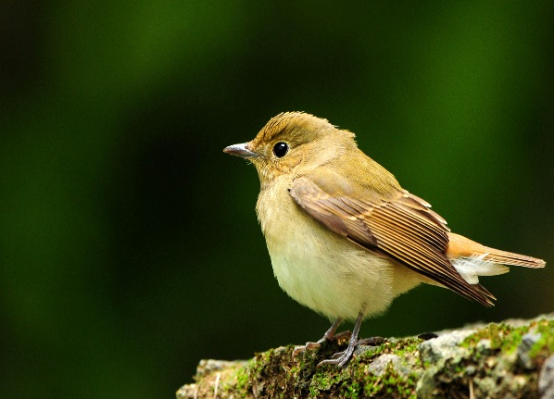

Observation 1
Identifying some critical patterns
Input
Layer 1
Layer 2
……
Bird?
……
……
……
……
……
Perhaps human also identify birds in a similar way … ☺
Notes:
https://www.dcard.tw/f/funny/p/233833012

Slide 6
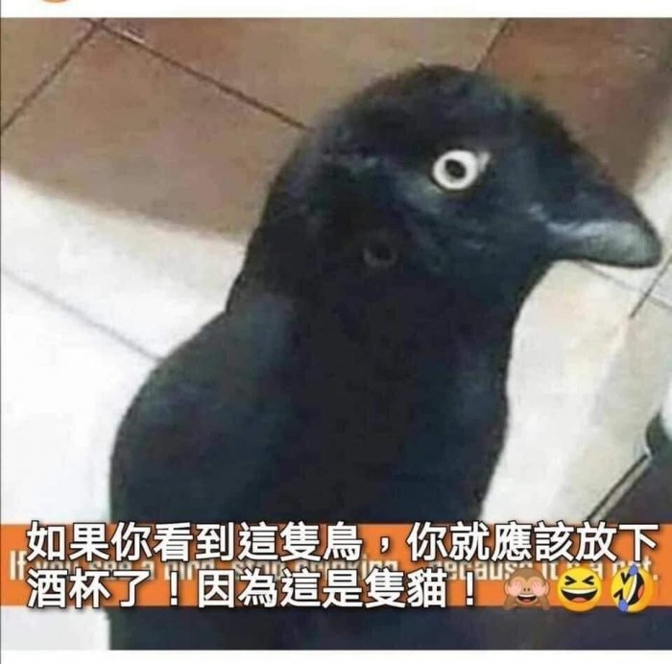
https://www.dcard.tw/f/funny/p/233833012

Slide 7
Observation 1
A neuron does not have to see the whole image.
Need to see the whole image?
Input
Layer 1
Layer 2
……
bird
……
……
……
……
……
basic
detector
advanced
detector
Some patterns are much smaller than the whole image.
Notes:
https://www.dcard.tw/f/funny/p/233833012

Slide 8
Simplification 1
3 x 3 x 3 weights
3 x 3
…...
bias
1
Receptive field
1 | 0 | 0 | 0 | 0 | 1
0 | 1 | 0 | 0 | 1 | 0
0 | 0 | 1 | 1 | 0 | 0
1 | 0 | 0 | 0 | 1 | 0
0 | 1 | 0 | 0 | 1 | 0
0 | 0 | 1 | 0 | 1 | 0
3 x 3
…...
1 | 0 | 0 | 0 | 0 | 1
0 | 1 | 0 | 0 | 1 | 0
0 | 0 | 1 | 1 | 0 | 0
1 | 0 | 0 | 0 | 1 | 0
0 | 1 | 0 | 0 | 1 | 0
0 | 0 | 1 | 0 | 1 | 0
1 | 0 | 0 | 0 | 0 | 1
0 | 1 | 0 | 0 | 1 | 0
0 | 0 | 1 | 1 | 0 | 0
1 | 0 | 0 | 0 | 1 | 0
0 | 1 | 0 | 0 | 1 | 0
0 | 0 | 1 | 0 | 1 | 0
3 x 3
…...

Slide 9
Simplification 1
Can different neurons have different sizes of receptive field?
Cover only some channels?
Not square receptive field?
3 x 3 x 3 weights
the same receptive field
Receptive field
1 | 0 | 0 | 0 | 0 | 1
0 | 1 | 0 | 0 | 1 | 0
0 | 0 | 1 | 1 | 0 | 0
1 | 0 | 0 | 0 | 1 | 0
0 | 1 | 0 | 0 | 1 | 0
0 | 0 | 1 | 0 | 1 | 0
1 | 0 | 0 | 0 | 0 | 1
0 | 1 | 0 | 0 | 1 | 0
0 | 0 | 1 | 1 | 0 | 0
1 | 0 | 0 | 0 | 1 | 0
0 | 1 | 0 | 0 | 1 | 0
0 | 0 | 1 | 0 | 1 | 0
1 | 0 | 0 | 0 | 0 | 1
0 | 1 | 0 | 0 | 1 | 0
0 | 0 | 1 | 1 | 0 | 0
1 | 0 | 0 | 0 | 1 | 0
0 | 1 | 0 | 0 | 1 | 0
0 | 0 | 1 | 0 | 1 | 0
Can be overlapped

Slide 10
Simplification 1 – Typical Setting
Each receptive field has a set of neurons (e.g., 64 neurons).
stride = 2
overlap
all channels
1 | 0 | 0 | 0 | 0 | 1
0 | 1 | 0 | 0 | 1 | 0
0 | 0 | 1 | 1 | 0 | 0
1 | 0 | 0 | 0 | 1 | 0
0 | 1 | 0 | 0 | 1 | 0
0 | 0 | 1 | 0 | 1 | 0
1 | 0 | 0 | 0 | 0 | 1
0 | 1 | 0 | 0 | 1 | 0
0 | 0 | 1 | 1 | 0 | 0
1 | 0 | 0 | 0 | 1 | 0
0 | 1 | 0 | 0 | 1 | 0
0 | 0 | 1 | 0 | 1 | 0
kernel size (e.g., 3 x 3)
1 | 0 | 0 | 0 | 0 | 1
0 | 1 | 0 | 0 | 1 | 0
0 | 0 | 1 | 1 | 0 | 0
1 | 0 | 0 | 0 | 1 | 0
0 | 1 | 0 | 0 | 1 | 0
0 | 0 | 1 | 0 | 1 | 0
padding
The receptive fields cover the whole image.
Notes:
守的滴水不漏無懈可擊

Slide 11
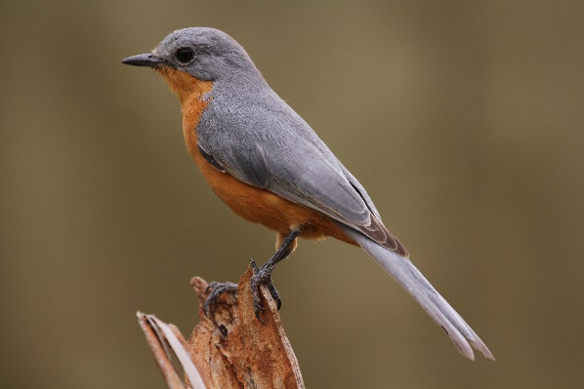
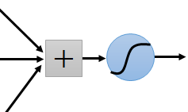
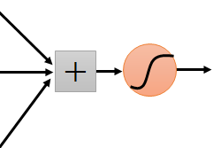
Observation 2
The same patterns appear in different regions.
I detect “beak” in my receptive field.
Each receptive field needs a “beak” detector?
I detect “beak” in my receptive field.

Slide 12
Simplification 2
3 x 3 x 3 weights
…...
bias
1 | 0 | 0 | 0 | 0 | 1
0 | 1 | 0 | 0 | 1 | 0
0 | 0 | 1 | 1 | 0 | 0
1 | 0 | 0 | 0 | 1 | 0
0 | 1 | 0 | 0 | 1 | 0
0 | 0 | 1 | 0 | 1 | 0
1
1 | 0 | 0 | 0 | 0 | 1
0 | 1 | 0 | 0 | 1 | 0
0 | 0 | 1 | 1 | 0 | 0
1 | 0 | 0 | 0 | 1 | 0
0 | 1 | 0 | 0 | 1 | 0
0 | 0 | 1 | 0 | 1 | 0
1 | 0 | 0 | 0 | 0 | 1
0 | 1 | 0 | 0 | 1 | 0
0 | 0 | 1 | 1 | 0 | 0
1 | 0 | 0 | 0 | 1 | 0
0 | 1 | 0 | 0 | 1 | 0
0 | 0 | 1 | 0 | 1 | 0
…
parameter sharing
3 x 3 x 3 weights
…...
bias
1
…

Slide 13










Simplification 2
$$x_{1}$$
$$σ\left(w_{1}x_{1}+w_{2}x_{2}+… \right)$$
$$x_{2}$$
$$w_{1}$$
…...
$$w_{2}$$
bias
1 | 0 | 0 | 0 | 0 | 1
0 | 1 | 0 | 0 | 1 | 0
0 | 0 | 1 | 1 | 0 | 0
1 | 0 | 0 | 0 | 1 | 0
0 | 1 | 0 | 0 | 1 | 0
0 | 0 | 1 | 0 | 1 | 0
1
1 | 0 | 0 | 0 | 0 | 1
0 | 1 | 0 | 0 | 1 | 0
0 | 0 | 1 | 1 | 0 | 0
1 | 0 | 0 | 0 | 1 | 0
0 | 1 | 0 | 0 | 1 | 0
0 | 0 | 1 | 0 | 1 | 0
1 | 0 | 0 | 0 | 0 | 1
0 | 1 | 0 | 0 | 1 | 0
0 | 0 | 1 | 1 | 0 | 0
1 | 0 | 0 | 0 | 1 | 0
0 | 1 | 0 | 0 | 1 | 0
0 | 0 | 1 | 0 | 1 | 0
…
$$x_{1}^{′}$$
$$σ\left(w_{1}x_{1}^{′}+w_{2}x_{2}^{′}+… \right)$$
$$x_{2}^{′}$$
$$w_{1}$$
…...
$$w_{2}$$
bias
Two neurons with the same receptive field would not share parameters.
1
…

Slide 14
Simplification 2 – Typical Setting
Each receptive field has a set of neurons (e.g., 64 neurons).
1 | 0 | 0 | 0 | 0 | 1
0 | 1 | 0 | 0 | 1 | 0
0 | 0 | 1 | 1 | 0 | 0
1 | 0 | 0 | 0 | 1 | 0
0 | 1 | 0 | 0 | 1 | 0
0 | 0 | 1 | 0 | 1 | 0
1 | 0 | 0 | 0 | 0 | 1
0 | 1 | 0 | 0 | 1 | 0
0 | 0 | 1 | 1 | 0 | 0
1 | 0 | 0 | 0 | 1 | 0
0 | 1 | 0 | 0 | 1 | 0
0 | 0 | 1 | 0 | 1 | 0
1 | 0 | 0 | 0 | 0 | 1
0 | 1 | 0 | 0 | 1 | 0
0 | 0 | 1 | 1 | 0 | 0
1 | 0 | 0 | 0 | 1 | 0
0 | 1 | 0 | 0 | 1 | 0
0 | 0 | 1 | 0 | 1 | 0
……
……

Slide 15
Simplification 2 – Typical Setting
Each receptive field has a set of neurons (e.g., 64 neurons).
Each receptive field has the neurons with the same set of parameters.
filter 1
1 | 0 | 0 | 0 | 0 | 1
0 | 1 | 0 | 0 | 1 | 0
0 | 0 | 1 | 1 | 0 | 0
1 | 0 | 0 | 0 | 1 | 0
0 | 1 | 0 | 0 | 1 | 0
0 | 0 | 1 | 0 | 1 | 0
filter 1
1 | 0 | 0 | 0 | 0 | 1
0 | 1 | 0 | 0 | 1 | 0
0 | 0 | 1 | 1 | 0 | 0
1 | 0 | 0 | 0 | 1 | 0
0 | 1 | 0 | 0 | 1 | 0
0 | 0 | 1 | 0 | 1 | 0
1 | 0 | 0 | 0 | 0 | 1
0 | 1 | 0 | 0 | 1 | 0
0 | 0 | 1 | 1 | 0 | 0
1 | 0 | 0 | 0 | 1 | 0
0 | 1 | 0 | 0 | 1 | 0
0 | 0 | 1 | 0 | 1 | 0
filter 2
filter 2
filter 3
filter 3
filter 4
filter 4
……
……

Slide 16
Benefit of Convolutional Layer
Fully Connected Layer
Jack of all trades,
master of none
Receptive Field
Parameter Sharing
Convolutional Layer
Larger model bias
(for image)
Some patterns are much smaller than the whole image.
The same patterns appear in different regions.
Notes:
Need an metaphor?

Slide 17
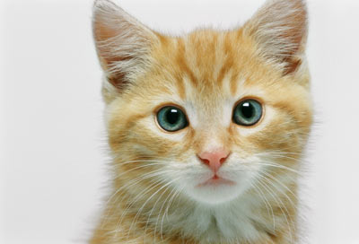
Convolutional Layer
Another story based on filter ☺
Filter 1
3 x 3 x channel
tensor
Convolution
Filter 2
3 x 3 x channel
……
tensor
……
channel = 3
(colorful)
Each filter detects a small pattern (3 x 3 x channel).
channel = 1
(black and white)
Notes:
64 filters

Slide 18
Convolutional Layer
Consider channel = 1
(black and white image)
1 | -1 | -1
-1 | 1 | -1
-1 | -1 | 1
1 | 0 | 0 | 0 | 0 | 1
0 | 1 | 0 | 0 | 1 | 0
0 | 0 | 1 | 1 | 0 | 0
1 | 0 | 0 | 0 | 1 | 0
0 | 1 | 0 | 0 | 1 | 0
0 | 0 | 1 | 0 | 1 | 0
Filter 1
-1 | 1 | -1
-1 | 1 | -1
-1 | 1 | -1
Filter 2
……
6 x 6 image
(The values in the filters are unknown parameters.)

Slide 19
Convolutional Layer
1 | -1 | -1
-1 | 1 | -1
-1 | -1 | 1
Filter 1
stride=1
1 | 0 | 0 | 0 | 0 | 1
0 | 1 | 0 | 0 | 1 | 0
0 | 0 | 1 | 1 | 0 | 0
1 | 0 | 0 | 0 | 1 | 0
0 | 1 | 0 | 0 | 1 | 0
0 | 0 | 1 | 0 | 1 | 0
3
-1
-3
-1
-3
1
0
-3
-3
-3
0
1
3
-2
-2
-1
6 x 6 image

Slide 20
Convolutional Layer
-1 | 1 | -1
-1 | 1 | -1
-1 | 1 | -1
Filter 2
stride=1
Do the same process for every filter
1 | 0 | 0 | 0 | 0 | 1
0 | 1 | 0 | 0 | 1 | 0
0 | 0 | 1 | 1 | 0 | 0
1 | 0 | 0 | 0 | 1 | 0
0 | 1 | 0 | 0 | 1 | 0
0 | 0 | 1 | 0 | 1 | 0
3
-1
-3
-1
-1
-1
-1
-1
-3
1
0
-3
-1
-1
-2
1
Feature
Map
-3
-3
0
1
-1
-1
-2
1
3
-2
-2
-1
6 x 6 image
-1
0
-4
3
Notes:
4 x 4 image

Slide 21
Convolutional Layer
3
-1
-3
-1
-1
-1
-1
-1
-3
1
0
-3
-1
-1
-2
1
-3
-3
0
1
-1
-1
-2
1
3
-2
-2
-1
-1
0
-4
3
64 filters
Convolution
“Image” with 64 channels
Convolution
……

Slide 22
Multiple Convolutional Layers
3
-1
-3
-1
-1
-1
-1
-1
-3
1
0
-3
-1
-1
-2
1
-3
-3
0
1
-1
-1
-2
1
3
-2
-2
-1
-1
0
-4
3
64 filters
Convolution
“Image” with 64 channels
Convolution
Filter:
3 x 3 x 64
……
64

Slide 23
Multiple Convolutional Layers
1 | 0 | 0 | 0 | 0 | 1
0 | 1 | 0 | 0 | 1 | 0
0 | 0 | 1 | 1 | 0 | 0
1 | 0 | 0 | 0 | 1 | 0
0 | 1 | 0 | 0 | 1 | 0
0 | 0 | 1 | 0 | 1 | 0
3
-1
-3
-1
64 filters
Convolution
-1
-1
-1
-1
-3
1
0
-3
-1
-1
-2
1
Convolution
-3
-3
0
1
-1
-1
-2
1
3
-2
-2
-1
……
-1
0
-4
3

Slide 24
Comparison of Two Stories
1 | -1 | -1
-1 | 1 | -1
-1 | -1 | 1
Filter
…...
3 x 3 x channel
tensor
Receptive field
(ignore bias in this slide)

Slide 25
The neurons with different receptive fields share the parameters.
…...
bias
1 | 0 | 0 | 0 | 0 | 1
0 | 1 | 0 | 0 | 1 | 0
0 | 0 | 1 | 1 | 0 | 0
1 | 0 | 0 | 0 | 1 | 0
0 | 1 | 0 | 0 | 1 | 0
0 | 0 | 1 | 0 | 1 | 0
1
1 | 0 | 0 | 0 | 0 | 1
0 | 1 | 0 | 0 | 1 | 0
0 | 0 | 1 | 1 | 0 | 0
1 | 0 | 0 | 0 | 1 | 0
0 | 1 | 0 | 0 | 1 | 0
0 | 0 | 1 | 0 | 1 | 0
1 | 0 | 0 | 0 | 0 | 1
0 | 1 | 0 | 0 | 1 | 0
0 | 0 | 1 | 1 | 0 | 0
1 | 0 | 0 | 0 | 1 | 0
0 | 1 | 0 | 0 | 1 | 0
0 | 0 | 1 | 0 | 1 | 0
…
…...
bias
Each filter convolves over the input image.
1
…

Slide 26
Convolutional Layer
Neuron Version Story
Filter Version Story
Each neuron only considers a receptive field.
There are a set of filters detecting small patterns.
The neurons with different receptive fields share the parameters.
Each filter convolves over the input image.
They are the same story.
Notes:
No going to use this page ……
Each filter convolves over the input image.

Slide 27
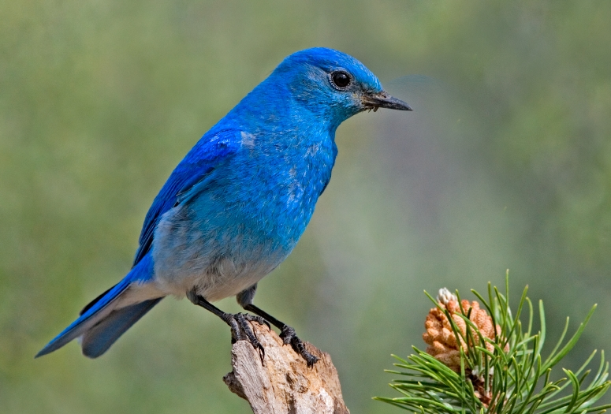

Observation 3
Subsampling the pixels will not change the object
bird
bird
subsampling
Notes:
We can subsample the pixels to make image smaller
Less parameters for the network to process the image

Slide 28
Pooling – Max Pooling
1 | -1 | -1
-1 | 1 | -1
-1 | -1 | 1
-1 | 1 | -1
-1 | 1 | -1
-1 | 1 | -1
Filter 1
Filter 2
3
-1
-3
-1
-1
-1
-1
-1
-3
1
0
-3
-1
-1
-2
1
-3
-3
0
1
-1
-1
-2
1
3
-2
-2
-1
-1
0
-4
3
Notes:
It does not have parameters
Like activation function, like relu, sigmoid

Slide 29
Convolutional Layers
+ Pooling
3
-1
-3
-1
-1
-1
-1
-1
-3
1
0
-3
-1
-1
-2
1
-3
-3
0
1
-1
-1
-2
1
3
-2
-2
-1
-1
0
-4
3
Convolution
“Image” with 64 channels
Repeat
Pooling
3
0
-1
1
3
1
0
3
……

Slide 30
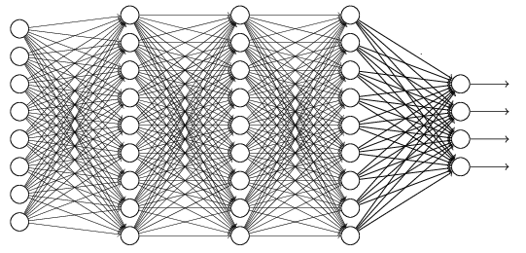
The whole CNN
cat dog ……
Convolution
softmax
Pooling
Fully Connected Layers
Convolution
Pooling
Flatten

Slide 31
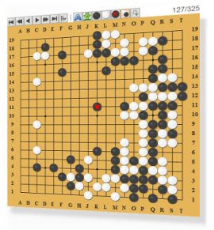
Application: Playing Go
Network
Next move
(19 x 19 positions)
19 x 19 classes
19 x 19 matrix (image)
19 x 19 vector
Black: 1
Fully-connected
network can be used
48 channels in Alpha Go
white: -1
none: 0
But CNN performs much better.
Notes:
Alpha Go is more complex.

Slide 32
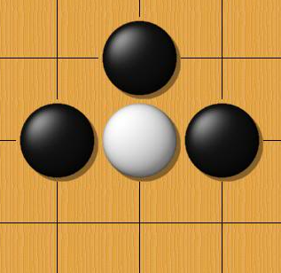
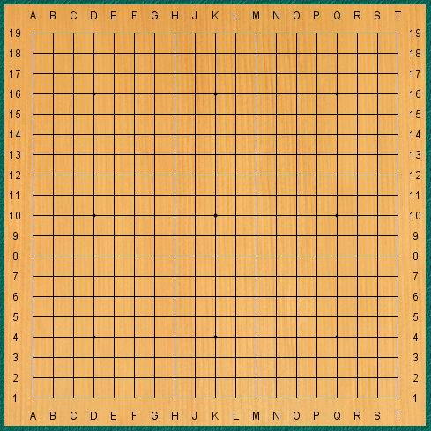
Why CNN for Go playing?
Some patterns are much smaller than the whole image
The same patterns appear in different regions.
Alpha Go uses 5 x 5 for first layer

Slide 33
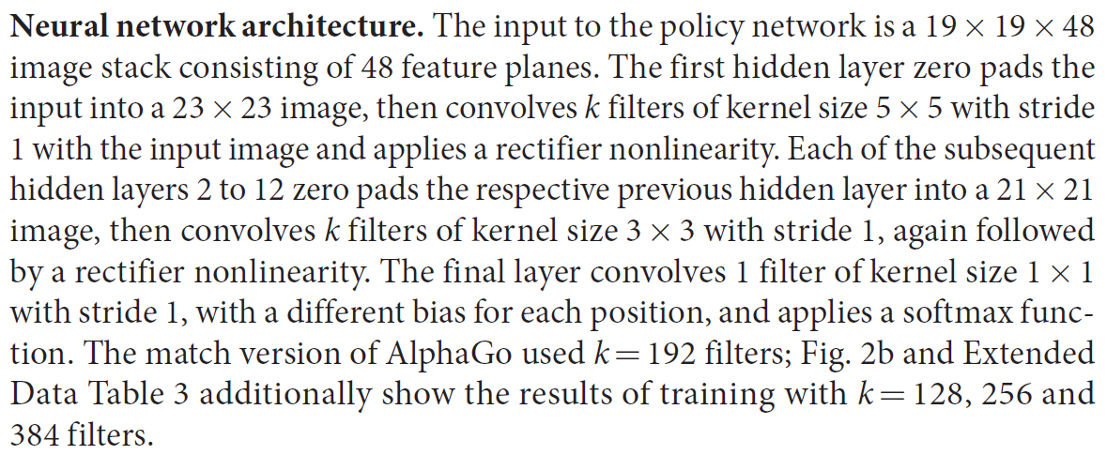
Why CNN for Go playing?
Subsampling the pixels will not change the object
Pooling
How to explain this???
Alpha Go does not use Pooling ……
Notes:
CNN is widely used
Very good example for designing your network

Slide 34
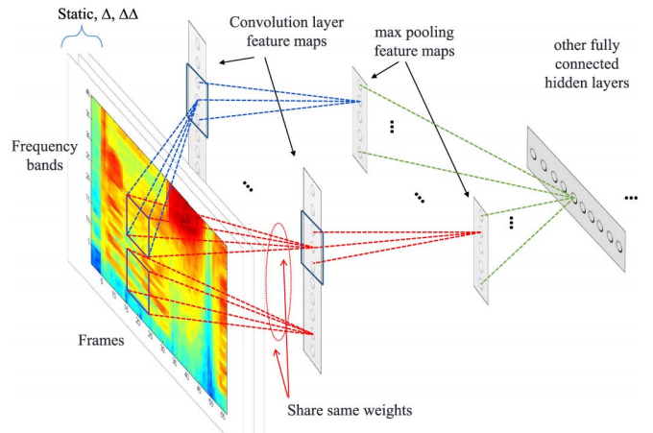
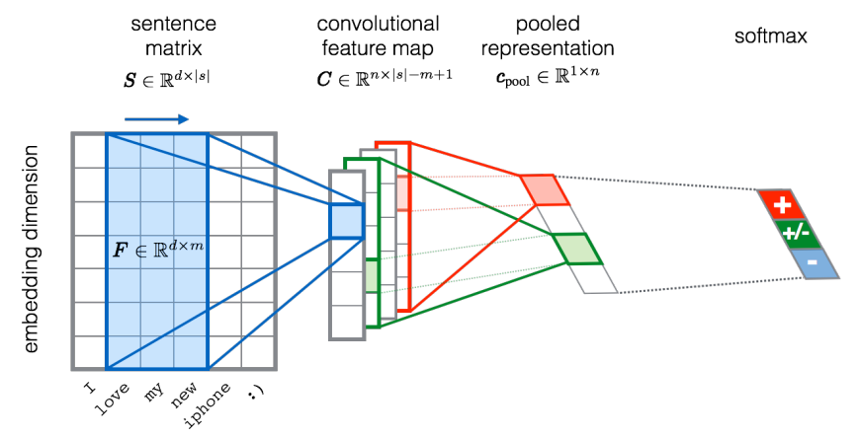
More Applications
Speech
https://dl.acm.org/doi/10.1109/TASLP.2014.2339736
Natural Language Processing
https://www.aclweb.org/anthology/S15-2079/

Slide 35
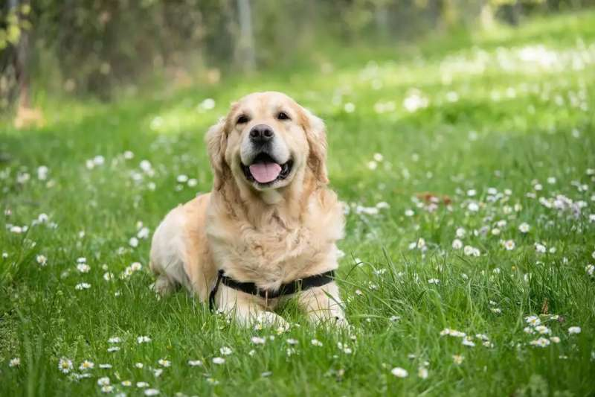


To learn more …
CNN is not invariant to scaling and rotation (we need data augmentation ☺).
Spatial Transformer Layer
https://youtu.be/SoCywZ1hZak
(in Mandarin)

